Slide 1
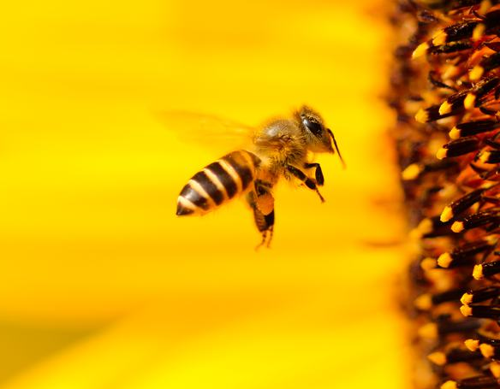
Bees
What’s the buzz about them?
Notes:
rachel

Slide 2
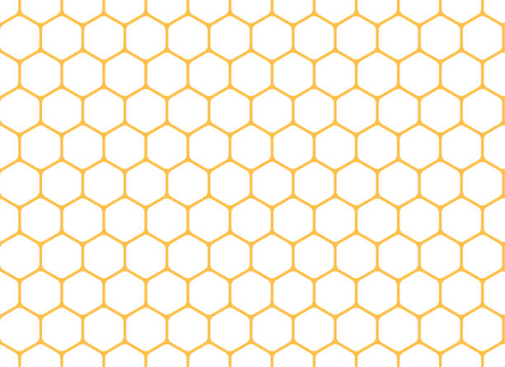
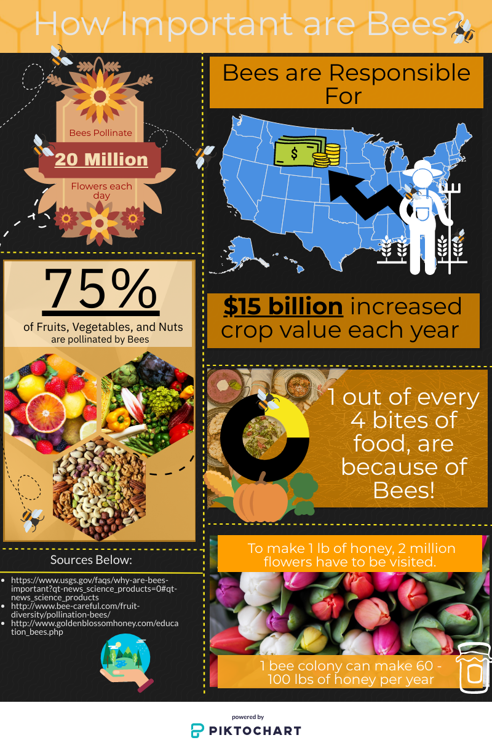
Notes:
rachel

Slide 3
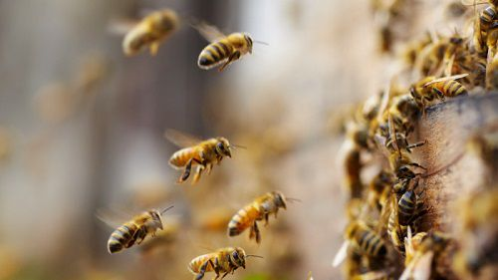
Our Hypothesis
As ambient temperature decreases, bee population decreases
As the average presence of pesticides in honey samples increased; bee population decreased
Notes:
jesse

Slide 4
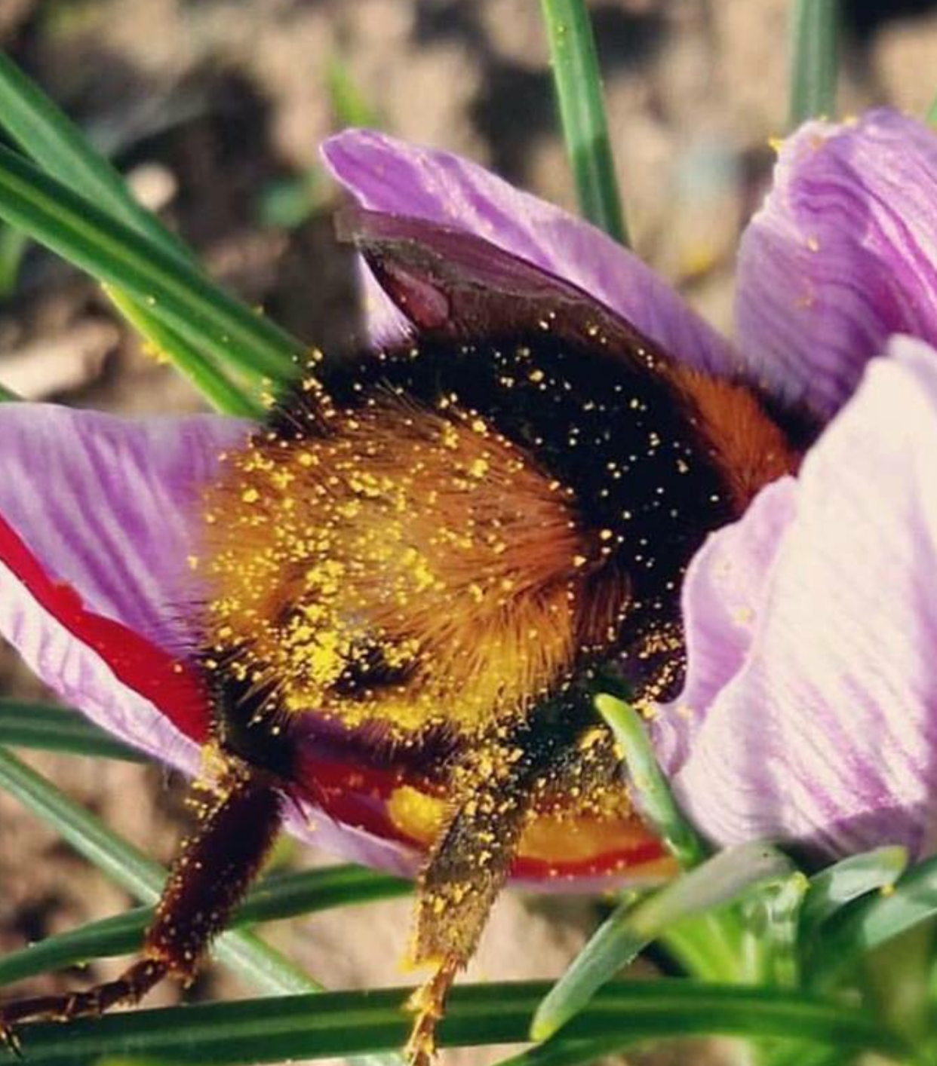
Our Questions:
How do natural and human influences impact bees?
How were we going to get this information?
Is this information reliable?
How were we going to get different data sets?
What is the relationship between honey sales and production?
Is there a dramatic decrease in bee population?
Notes:
jeff

Slide 5

Bee Colony Data
All Bee Data was found using the https://quickstats.nass.usda.gov/ API through USDA.
The data provided only includes numbers of honey producing colonies for operations with five or more colonies.
Notes:
jeff

Slide 6
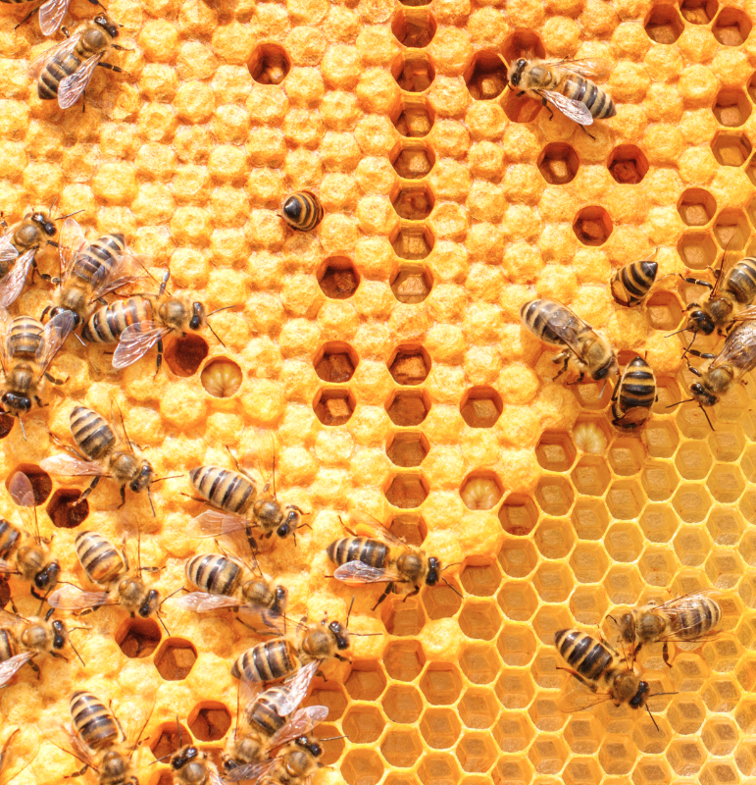
Challenges of Bee Data
While the data was given to us in a csv , we instead built an API to collect and parse through the data.
There were numerous issues in generating the correct syntax but eventually we became quite competent in the USDA API.
Different things to account for during data cleanup were:
Values coming over as objects
Removal of , or .
Converting to strings.
Dealing with different date/time issues, specifically working with quarters and years and generating a meaningful graph.
Notes:
jeff

Slide 7
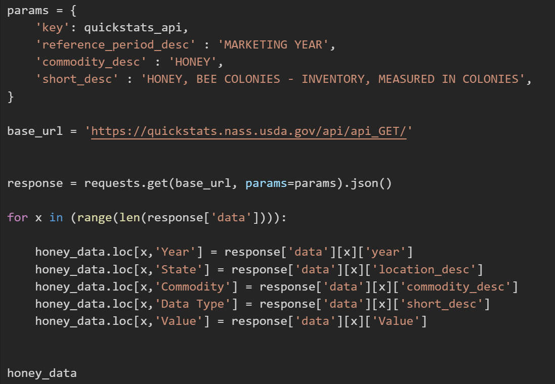
USDA API
Notes:
jeff

Slide 8
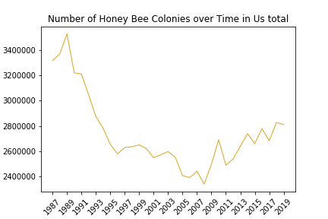
US Bee Colonies over time
Notes:
jeff

Slide 9
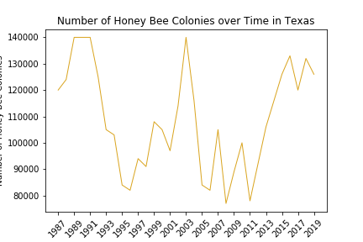
Texas Bee Colonies over time
Notes:
jeff

Slide 10
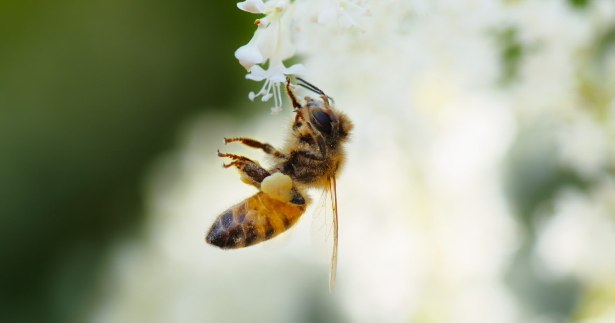
Bee Colony Summary
Bee colonies were hit heavily during the 90s and 00s
Have since started to recover
This damage can be attributed to many different factors
Notes:
Jeff

Slide 11
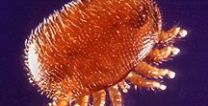
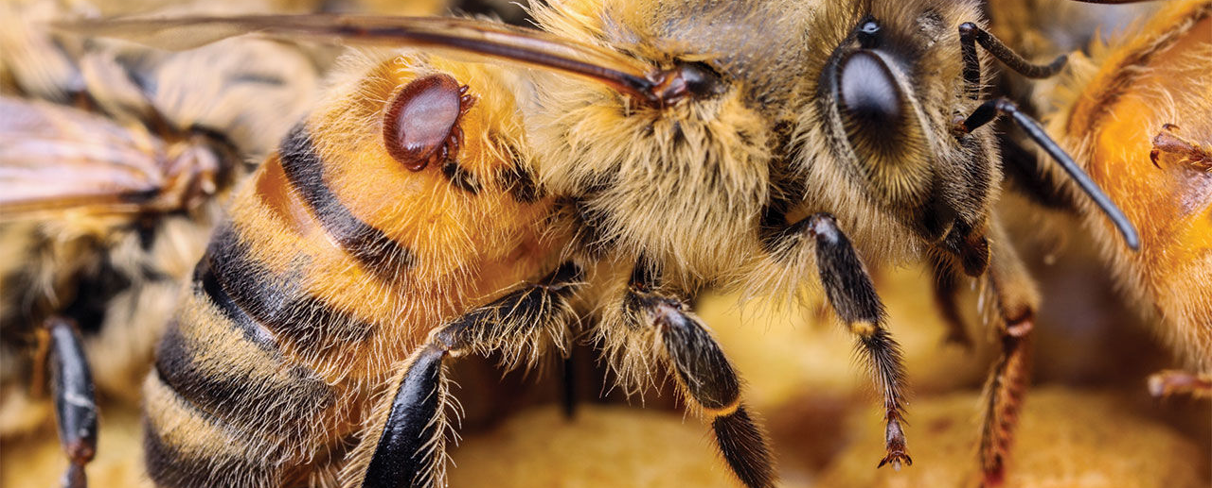
Bee Analysis
The colony process has the ability to generate a graph for each state as well as the US Total
Allowed us to see multiple trends of decreasing colony counts during the 90s-00s and colony recovery during the 10s.
While parsing through the data we were able to determine that Varroa Mites were a main pest that affected bee colonies.
If we had more time, would be interested in diving deeper into how the Bee colonies were directly affected by Varroa Mites.
Notes:
jeff

Slide 12
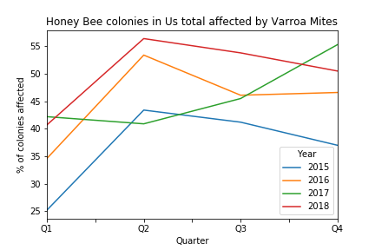
US Colonies affected by Varroa Mites
Notes:
jeff

Slide 13
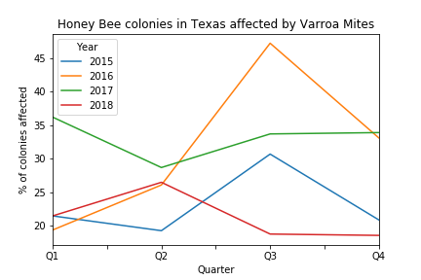
Texas Bee Colonies affected by Varroa Mites
Notes:
Jeff

Slide 14
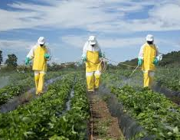
Pesticide Data
The USDA website hosts the Pesticide Data Program (PDP) database which was initiated in 1991.
Collecting this data required navigating this very buggy user interface with trial-and-error until the desired data set was found.
Then the data was conveniently downloaded in CSV format (no API pull required).
Unfortunately, this was the most recent granular data we could find on pesticides relating to honey.
Notes:
Jesse

Slide 15
Pesticide Data Cleanup
Data clean-up was necessary. The data set had columns with missing cells and entire rows which were unnecessary for our purposes.
Used loc function and list comprehension on some data points and using the drop function for entire columns.
The most difficult element to clean was the needed date data which was embedded in a complex string under the ‘Sample ID’ column. This required using the pandas.dataframe.str.slice() function to target the needed data.
The pandas.dataframe.to_datetime() function required the string to be rearranged which required slicing out small pieces of the string and then bringing them all back together by concatenating them adding columns together into a new column variable named ‘Months.’
Notes:
Jesse

Slide 16
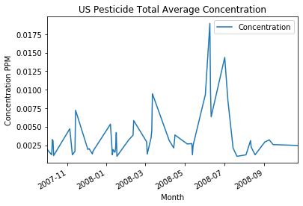
US Pesticide Average Concentration
Notes:
Jesse

Slide 17
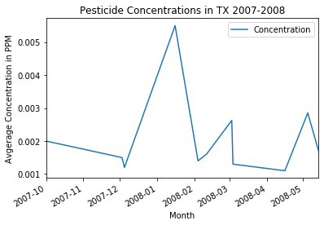
Texas Pesticide Concentration
Notes:
Jesse

Slide 18
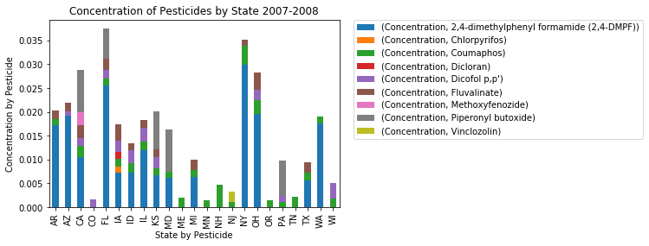
Pesticide Concentration by State
Notes:
Jesse

Slide 19
Pesticide Summary
We the concentration of pesticide in honey indicates more or lesser use of said pesticide.
There was a clear spike in pesticide concentration between 2008-05 and 2008-09.
Most used pesticide across the set is 2,4-dimethylphenyl formamide.
Also found on catfish.
Notes:
Jesse
The US Pesticide Total Average Concentration graph shows the total average concentration of detected pesticides in samples across the United States within the indicated month from 2007 to 2008. We assert the concentration of pesticide in honey indicates more or lesser use of said pesticide. There was a clear spike in pesticide concentration between 2008-05 and 2008-09.
The Concentration of Pesticides by State 2007-2008 shows the average concentration of pesticide by pesticide per state. It is immediately clear the most used pesticide across the set is 2,4-dimethylphenyl formamide. The only thing we can tell you about it is also found on catfish. It is important to note that sample collection data across states were not uniform, however, the data represents average concentration by pesticide so the results are adjusted.

Slide 20


Temperature Data
Temperatures found on NOAA’s website through API pulls
Add semi-decent documentation
Had records of weather data going back to 1700’s
Used weather station data (99% coverage)

Slide 21
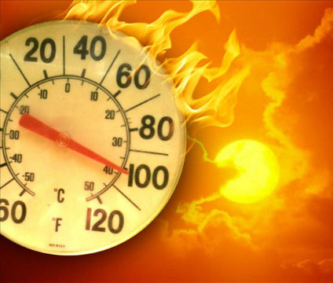
Challenges of Temperature
Narrowing down search
Pulling API with Header
Comparing data to bees
Months vs Years
Converting date
Putting multiple line graphs onto one plot

Slide 22
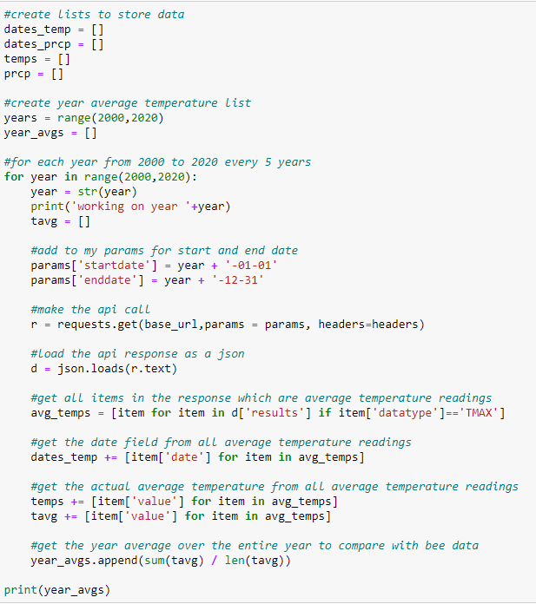
Producing data through an API call

Slide 23
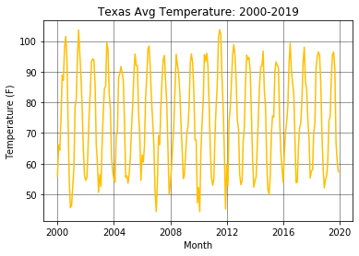
Found the Texas monthly average temperature across 19 years.

Slide 24
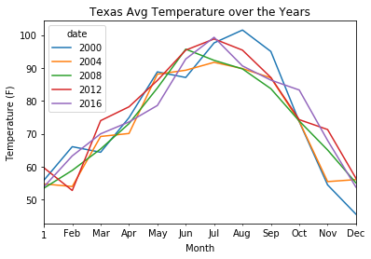
Compared years in four year increments to find any drastic changes

Slide 25
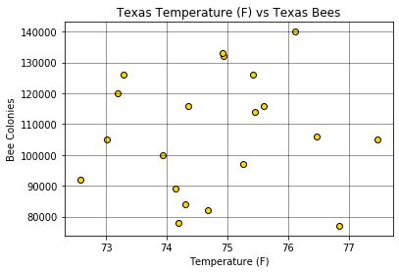
Tried to find a correlation between the Temperature in Texas and Bee Colonies in Texas

Slide 26
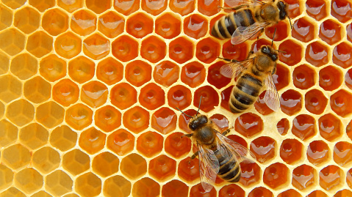
Temperature Data Summary
With r-value = .0679, no notable correlation between TX Temperature and TX Bees
Temperature in Texas is fairly consistent
No drastic changes/spikes between years

Slide 27

Honey Sales
Found data on USDA website.
Downloaded CSV file
Filtered through census and survey data
Able to find information on honey sales and production both on a state and national level.
Notes:
Matthew

Slide 28
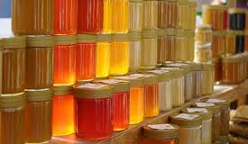
Honey Sales Challenges
Tricky searching for the data
Able to find multiple datasets for honey:
Production
Location
Sales
Trail and error finding the right CSVs.
Had to download multiple CSVs to get both the census and survey data required for the analysis.
Using pandas and matplotlib, constructed several graphs.
Converted cent values to dollar figures and made a multiline graph to display findings
Notes:
Matthew
. I began with honey production data over 5 year intervals, ending with line graphs to display the census data of honey production for both Texas and then the U.S. as a whole.

Slide 29
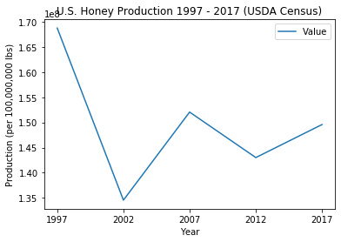
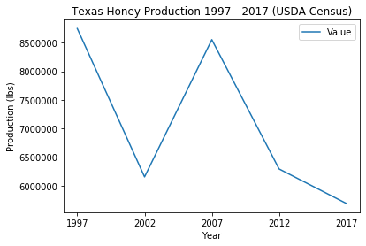
US and Texas Honey Production

Slide 30
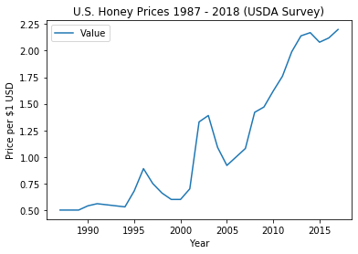
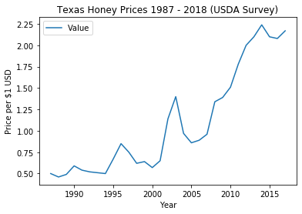
US and Texas Honey Prices
Notes:
Matthew

Slide 31
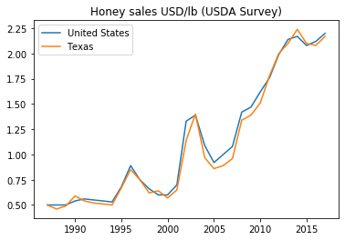
US vs Texas Honey Sales

Slide 32
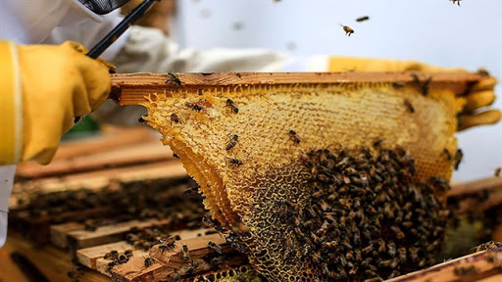
Honey Production Summary
Honey production sharply decreased from 1997 to 2002 and then increased from 2002 to 2007 for both Texas and the U.S.
After production sharply declines, with Texas continuing to decline in production and the U.S. appears to be bouncing back as of 2017.
For prices, Texas follows the national trend closely.
There could be a number of factors that could be the cause
Laws
Taxes
New agricultural bills
Cultural and Economic shifts (such as the 2008 recession)
Changes in marketing methods, etc.
How our environment and agricultural practices can affect our businesses
Notes:
These observations help raise further questions from an economic perspective and will hopefully draw more interest into seeking answers into how our environment and agricultural practices can affect our businesses as well

Slide 33

Conclusions/Implications
The r-value for correlation between ambient temperature and bee population was .069 which disproves our hypothesis.
There was insufficient data regarding current pesticide measurements
Impossible to prove or disprove our second hypothesis.
Varro Mites and Pesticides
Sales Rising
Tax passed?

